Slide 1
Node.js: Getting Started
COURSE OVERVIEW

Slide 2
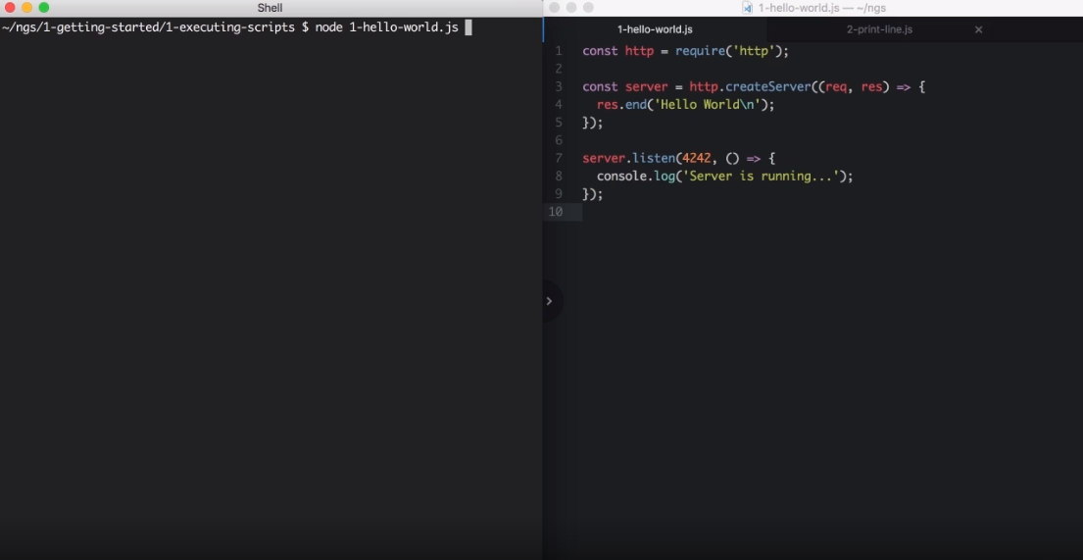

Slide 3
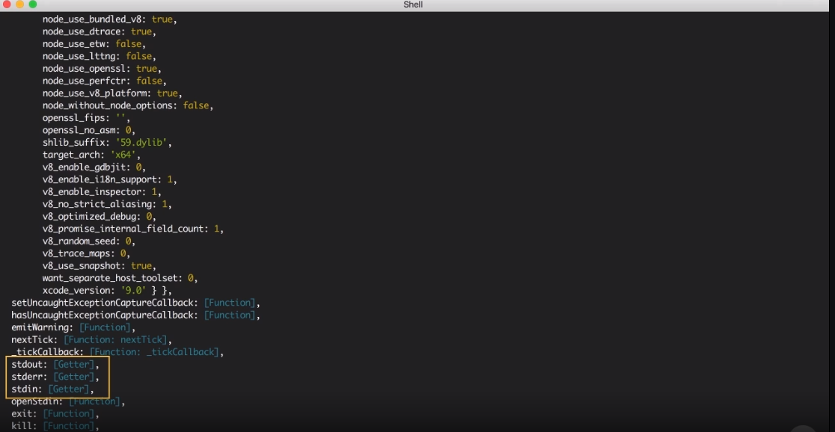

Slide 4
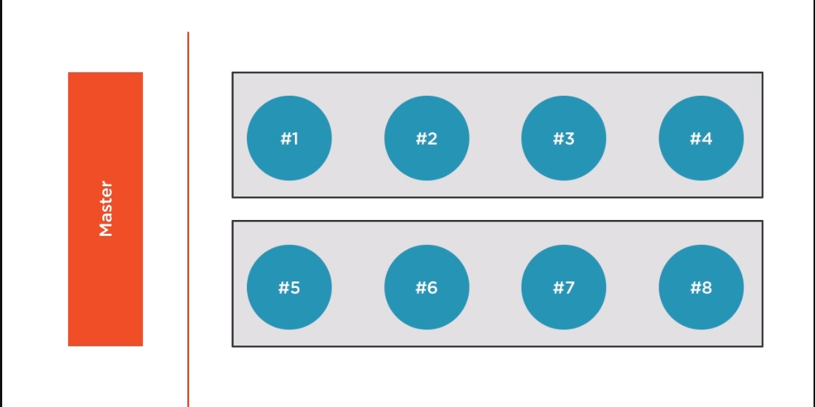

Slide 5
